Slide 1
CODEALPHA INTERNSHIP | TASK 03
Minahil Amjad (ID: CA/DF1/299347)
Digital Marketing Campaign Strategy
Smart Living 2026: Omnichannel Launch Campaign
Accelerating D2C Acquisition & High-ROI Conversion for TechTrend Solutions
CAMPAIGN DURATION
TARGET REVENUE
CORE OBJECTIVE
90 Days (Q2 Execution)
$120,000 Sales
Scale ROAS > 3.5x

Slide 2
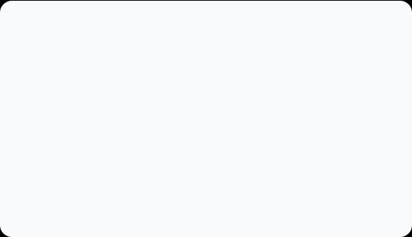
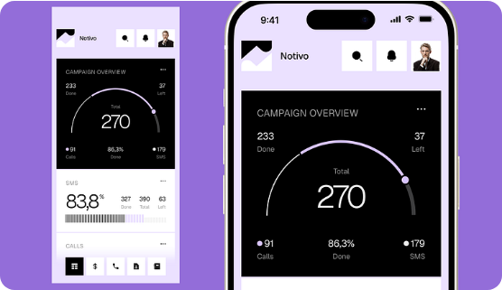
01. EXECUTIVE OVERVIEW
Strategic Campaign Blueprint
The Smart Living 2026 campaign positions TechTrend Solutions as the ultimate D2C destination for intuitive smart home eco-systems.
Primary Goal
Drive 2.5M impressions and capture 8,500 qualified customer leads.
Core Focus
Short-form UGC video ads combined with intent-driven search retargeting.
TechTrend Solutions Campaign Proposal
Slide 2 / 9

Slide 3



02. AUDIENCE STRATEGY
Target Customer Segments
Tech Professional
Smart Home Upgrader
Gift Shoppers
Ages 25–40 | Tech Enthusiasts
Ages 30–50 | Modern Homeowners
Ages 22–45 | Seasonal Buyers
Seeks desk productivity tools, ergonomic gadgets, and smart lighting systems.
Wants plug-and-play security cameras, automated plugs, and energy savers.
Attracted by packaged gift bundles, fast delivery, and premium packaging.
TechTrend Solutions Campaign Proposal
Slide 3 / 9

Slide 4
03. MEDIA MIX
Social Media Activation Plan
Platform | Primary Role | Content Format | Frequency
Instagram | Aesthetic Showcase & UGC | Reels & Carousel Posts | 5x / week
TikTok | Viral Product Demos | Short Problem-Solution Shorts | 6x / week
YouTube | In-Depth Reviews & Setup | Shorts & Creator Integration | 2x / week
Facebook | Retargeting & Community | Image Ads & Customer Reviews | 4x / week
TechTrend Solutions Campaign Proposal
Slide 4 / 9

Slide 5
04. CREATIVE CONCEPTS
High-Converting Content Angles
ANGLE 01
ANGLE 02
ANGLE 03
"Desk Setup Makeover"
"Unboxing & Real Test"
"Problem vs. Solution"
Time-lapse transformation of messy workspaces into sleek smart hubs using TechTrend products.
Raw micro-influencer footage testing plug-and-play smart lights and voice control response times.
Highlighting high electricity bills vs. automated savings via TechTrend Smart Energy Plugs.
TechTrend Solutions Campaign Proposal
Slide 5 / 9

Slide 6
05. PAID FUNNEL
Full-Funnel Paid Advertising Strategy
STAGE 1: TOFU
STAGE 2: MOFU
STAGE 3: BOFU
Awareness
Consideration
Conversion
Broad demographic video ads on Meta & TikTok focusing on brand discovery and viral clips.
Google Search intent ads, influencer comparisons, and lead magnet discounts for signups.
Dynamic catalog ads for cart abandoners with limited-time 15% discount triggers.
TechTrend Solutions Campaign Proposal
Slide 6 / 9

Slide 7
06. FINANCIAL PLAN
Campaign Budget Allocation ($15,000 Total)
Meta Ads (FB/IG) - 40%
$6,000
Total Estimated Spend
Google Search & Shopping - 25%
$3,750
$15,000
Influencer Seeding & UGC - 20%
$3,000
Target Revenue: $120,000 (8x Pipeline)
Creative Production & Software - 15%
$2,250
TechTrend Solutions Campaign Proposal
Slide 7 / 9

Slide 8
07. SUCCESS METRICS
Projected Campaign Impact
2.5M
8,500
3.5x
$120K
Ad Impressions
Leads Captured
Blended ROAS
Total Revenue
Across Meta & TikTok
Email & SMS Signups
Paid Media Return
In 90-Day Window
TechTrend Solutions Campaign Proposal
Slide 8 / 9

Slide 9
Campaign Ready for Execution
Thank You! Questions & Discussion
Prepared by Minahil Amjad for CodeAlpha Business & Marketing Internship Evaluation.
Student ID: CA/DF1/299347
Company: TechTrend Solutions

Slide 10

Image Sources
https://cdn.dribbble.com/userupload/47531924/file/d3fd13d937cb330f0957ca5d1265def7.png?resize=752x&vertical=center
Source: dribbble.com

